Slide 1
Macbeth v. Throne of Blood
EA 190 Comparative Assignment #1

Slide 2
Visual Transformation
Shakespeare’s Macbeth is a perfect expression of a historic form of regicide. At a time where the masses had their own idea of unifying the nation along with power struggle and civil disorder between the upper rankings, the efforts to properly locate a successor resulted in civil unrest and eventually blood was spilt. As history would often repeat itself, King Duncan’s father eliminated everyone in order to secure his son’s place as king. But what was so unfortunate about Duncan’s fate was how he ran into Macbeth in the north of Scotland. This is where Kurosawa’s ambitions for a tradition of violence surfaced as he was constructing his own vision of this type of power struggle.
Kurosawa embraced a rather similar era of civil war in Japan. The imperial city of Kyoto was destroyed from 1467 to 1477 due to the Onin war at which the nation entered a prolonged time of turmoil. The Age of the Country at War which is referred to as “Sengoku Jidai” was marked by many conflicts between different clans and a central power that lacked a sense of direction

Slide 3
Japanese armor classification
The classification of Japanese armor greatly varies upon design and the era of which it was erected.
The cuirass (do) featured different construction—scales, lamellae or full-plate—during different periods of Japanese history.
The helmet (kabuto) and cuirass (do) are the oldest parts of the Japanese armour.
The face mask (men yoroi), which literally means "face armour," was very popular but few samurai used it on the battlefield because they wanted their face to be visible to the enemy.
Up to the middle of the 12th century the armoured sleeves (kote) actually were only one sleeve, worn on the left arm to protect it from the bow-string.
The greaves (suneate) protect the legs, but the earliest ones offered no protection for the knees.

Slide 4
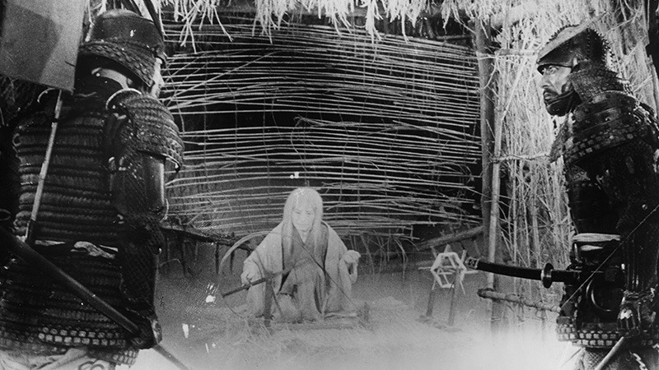
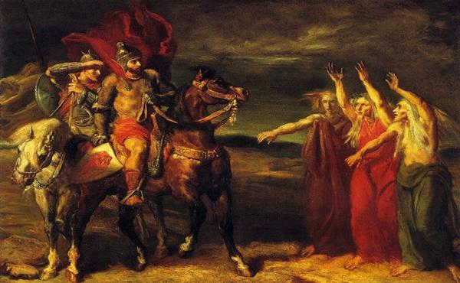
Interpretations of the Prophet
-When one gets promoted, the new atmosphere becomes very unfamiliar to because how he once viewed the world has changed.
-In old literature, what was saw as fit was defined as cleave
- What was seen as the next generation was defined as strange or unusual
-When it comes to today’s fashion people usually would not see something new as trendy until their mind tolerated it.
-Here Banquo is trying to describe how Macbeth was mentally trying on his new title as Thane of Cawdor but it is until he fully gets used to it does he really deserve to be honored in that fashion
"New honors come upon him, / Like our strange garments, cleave not to their mould / But with the aid of use" (1.3.144-146),
Forest Spirit vs.
Wierd Sisters

Slide 5
Macbeth’s Armor
-Macbeth’s armor strongly represents power that was not righteously earned along with privileges that had to be stolen to be obtained.
- The Crown of King Duncan clearly represents class and royalty that is suppose to be endowed unquestionably.
-At the very beginning where the witches notify Macbeth of his title as the Thane of Cawdor, they also notified him of his accension to the crown as King. But as soon as he discovers this prophecy he begins to wonder how that position would be obtainable. "If chance will have me king, why, chance may crown me, without my stir." (I,III, 154-156). All this ties Macbeth to how he would obtain the title as King and if he even wants to go throught the hassle of getting there in the first place.

Slide 6
Throne of Blood
Much more spectacle can be witnessed from Throne of Blood than in Macbeth. Clothing from Throne of Blood greatly enhances the plot rather then distracts from it.
Macbeth's clothing resembles the great probability of the Theory of Tragedy in the works.
Clothing in Throne of Blood represents none other than the thoughts and feelings of the characters hidden underneath.

Slide 7
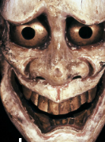
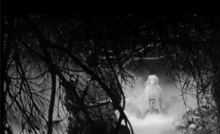
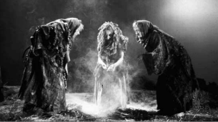
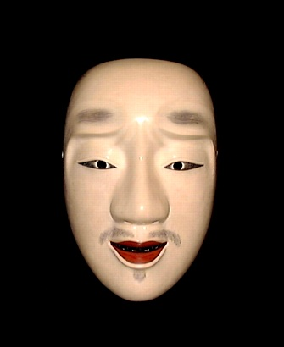
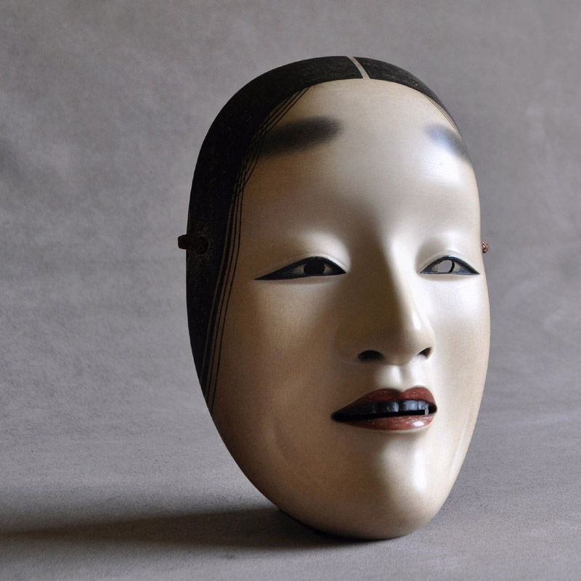
Hiragata-hannya
The difference between dark and light is relevant when comparing knowledge and ignorance
Spirits in Macbeth
Noh masks along with heavy make up display facial expressions of each character in Throne of Blood
-Shiro-shakumi
Chujo

Slide 8
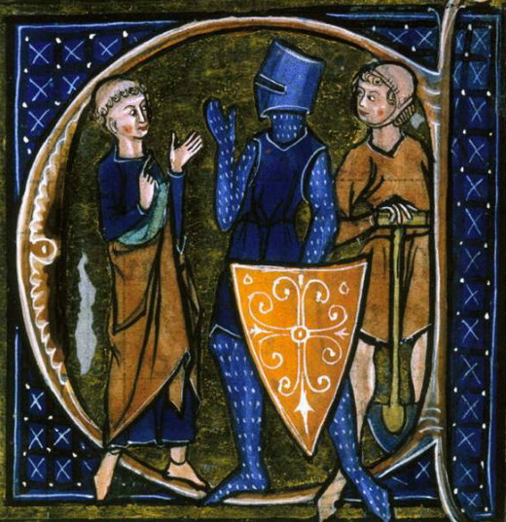
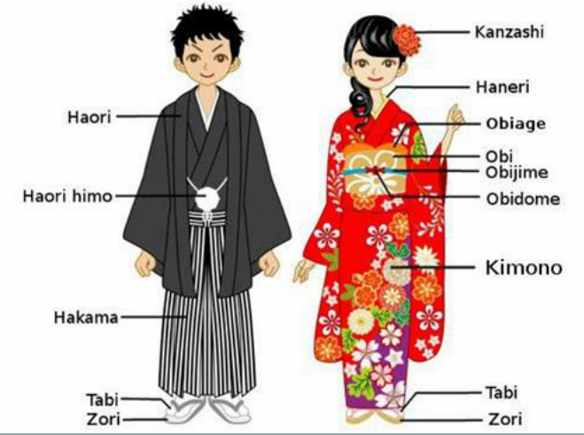
Gown

